Slide 1
Emergence of nonreciprocal interactions and phase transitions in optically assembled nanomaterials
John Parker

Slide 2
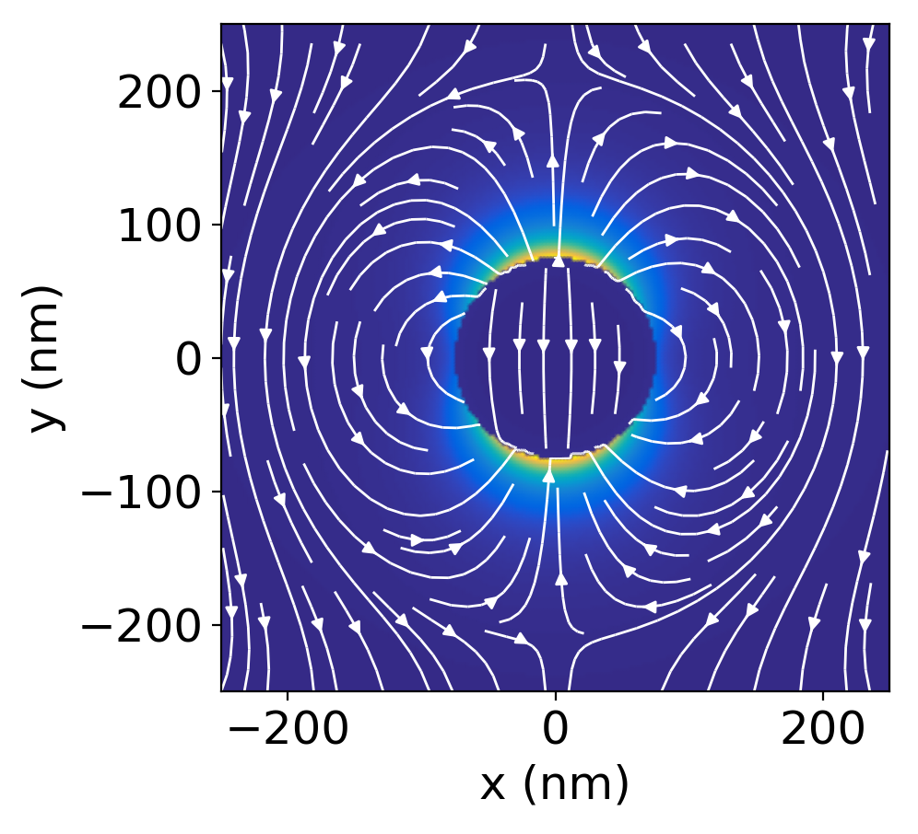
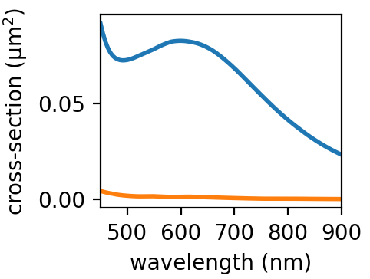
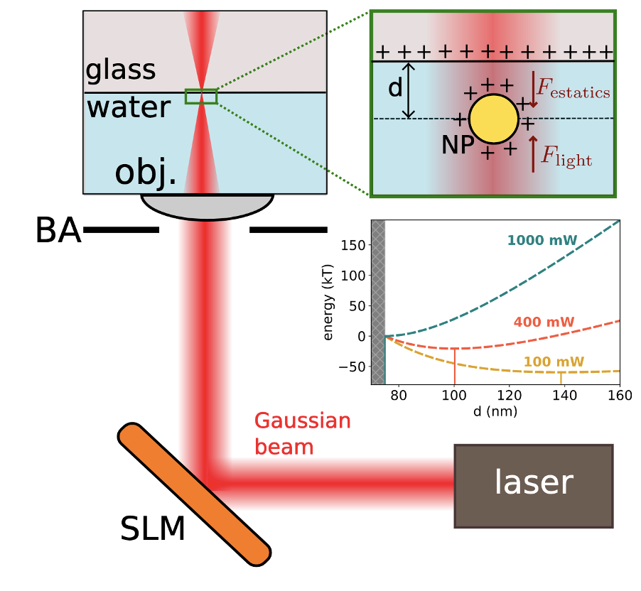
Trapping a single particle in a Gaussian beam
Dipole field around a 150 nm diameter silver nanoparticle
Scattering and absorption of the nanoparticle particle
Optical setup for trapping nanoparticles
scattering
absorption
Nanoparticle polarizability (Raleigh approximation)
$$α\left(ω\right)=α^{′}\left(ω\right)+iα^{′′}(ω)$$
$$p\left(ω\right)=α\left(ω\right)E_{inc}$$
Trapping particles in the $z$-direction
$$F_{z}=F_{rad}−F_{Coulomb}=0$$

Slide 3
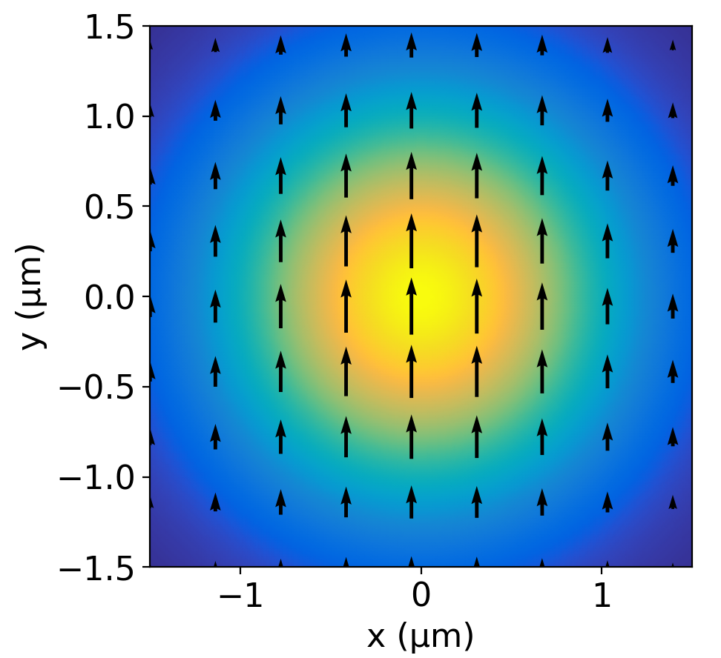
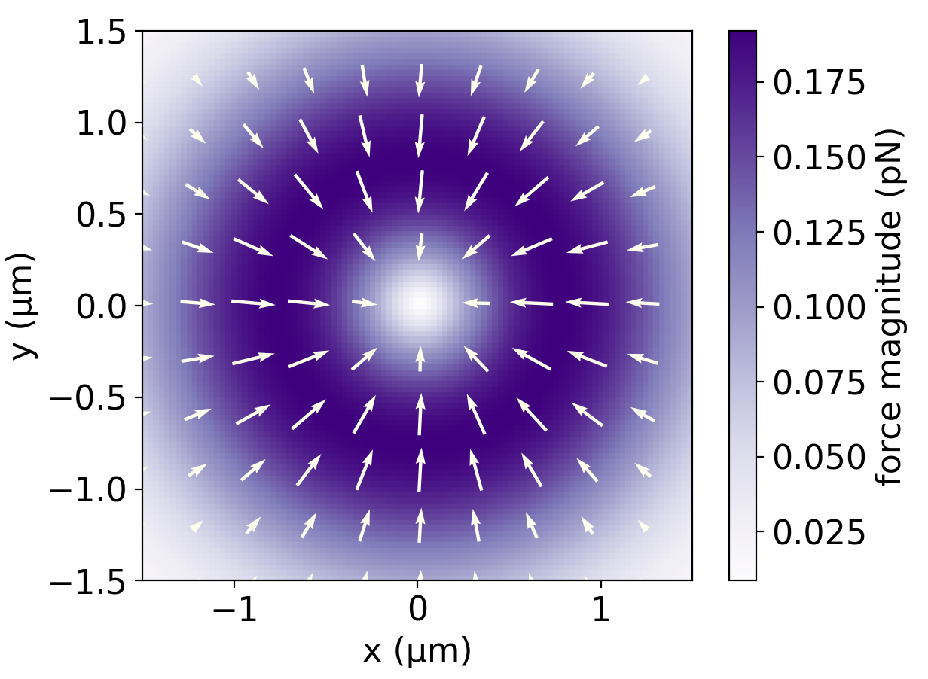
Trapping a single particle in a Gaussian beam
Brownian dynamics simulation for the trajectory of the trapped particle
y-polarized Gaussian beam
Force field for trapped nanoparticle
Focused beam profile (monochromatic)
Optical intensity and phase gradient forces (trapping in $xy$-plane)
Brownian fluctuations from the thermal bath (water medium)

Slide 4
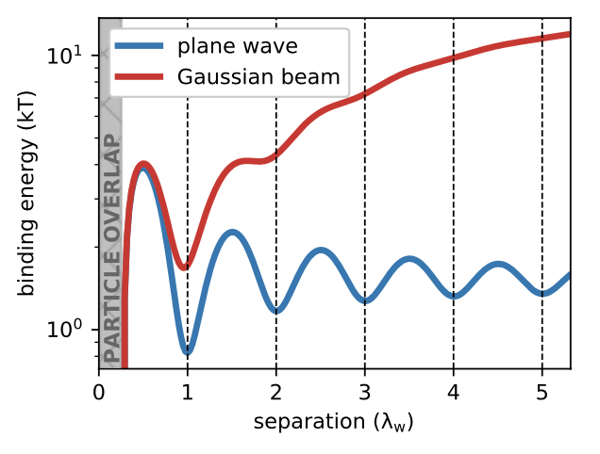
Two particles interact with each other electrodynamically to form a bound dimer
Optical binding energy for two particles
When a second particle is added to an optical trap, it interacts electrodynamically with the other particle
The binding is stable at various optical binding separations
$δ=n{ λ}_{w} n=1, 2, …$
$$δ$$

Slide 5
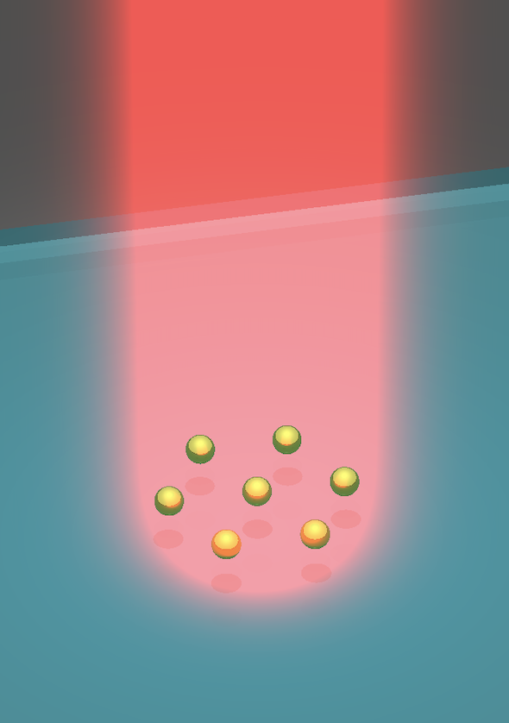
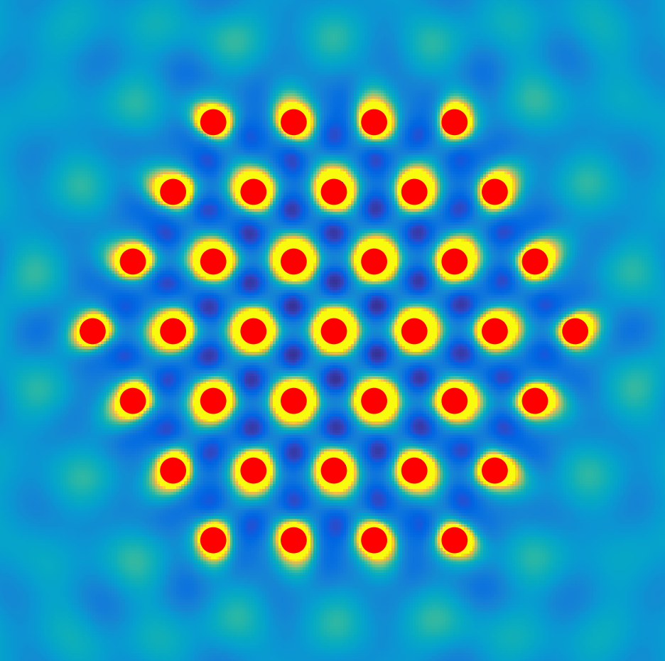
Building larger optical matter arrays in circularly polarized light
Building optical matter arrays 1 particle at a time (colormap = light intensity)
37 nanoparticle optical matter array
Interference between incident and scattered fields
3D view
$$I(\vec{r})={\left({\vec{E}}_{inc}(\vec{r})+\sum_{i}{{{\vec{E}}^{i}}_{scat}}(\vec{r})\right)}^{2}$$
Force field landscape
$$\vec{F}(\vec{r})∝\vec{∇}I(\vec{r})$$

Slide 6
Visualizing the construction of optical matter in simulation and experiment
Experiment showing assembly of optical matter
XZ view of optical matter
XY view of optical matter
Zijie Yan

Slide 7
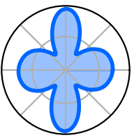
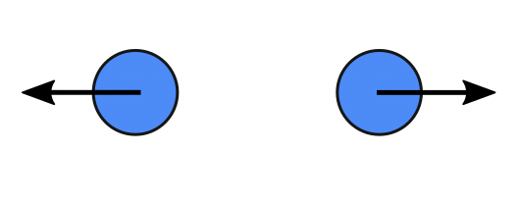
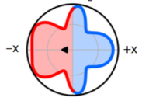
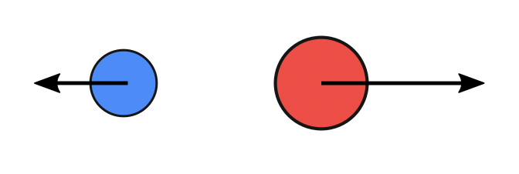
Action does not equal reaction in an optically bound hetero-dimer
Far-field angular scattering (symmetric)
Optically bound homo-dimer
$${\vec{F}}_{1}$$
$${\vec{F}}_{2}$$
For two identical particles, Newton’s third law is valid
For two dissimilar particles, Newton’s third law is not valid
Linear momentum is still conserved in the combined optical – mechanical system
$${\vec{F}}_{1}=−{\vec{F}}_{2}$$
$$F^{net}=0$$
Far-field angular scattering (asymmetric)
Optically bound hetero-dimer
$${\vec{F}}_{1}$$
$${\vec{F}}_{2}$$
$$F^{net}$$
$${\vec{F}}_{1}≠−{\vec{F}}_{2}$$
Yifat, Y., Coursault, D., Peterson, C.W., Parker, J., Bao, Y., Gray, S.K., Rice, S.A. and Scherer, N.F., 2018. Reactive optical matter: light-induced motility in electrodynamically asymmetric nanoscale scatterers. Light: Science & Applications, 7(1), pp.1-7.

Slide 8
Observing a driven hetero-dimer in simulation and experiment
Experiment
Plane-wave
In a plane-wave, the hetero-dimer will be driven forever
The net force is not external; it emerges from the optical interactions
The driven motion can be observed experimentally in a ring trap (that does not have an azimuthal phase gradient)
$$F^{net}$$
Ring trap
Hetero-dimer (driven)
Homo-dimer (not driven)
Yuval Yifat, Curtis Peterson
Yifat, Y., Coursault, D., Peterson, C.W., Parker, J., Bao, Y., Gray, S.K., Rice, S.A. and Scherer, N.F., 2018. Reactive optical matter: light-induced motility in electrodynamically asymmetric nanoscale scatterers. Light: Science & Applications, 7(1), pp.1-7.

Slide 9
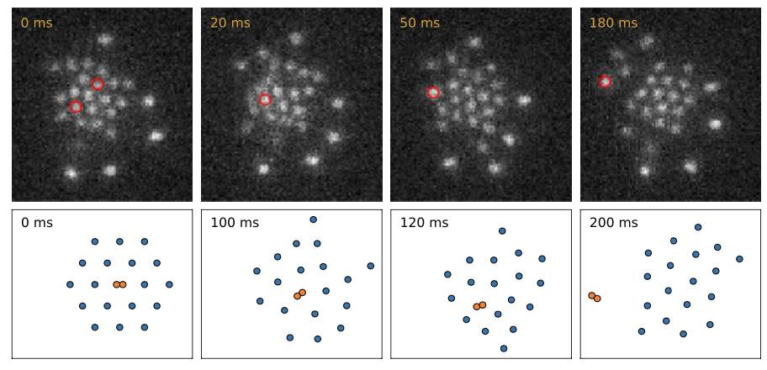
An intruder particle is expelled from an optical matter array though non-reciprocal interactions
An intruder particle is ejected from an array by non-conservative forces
Animation of escape
Emmanuel Valenton, Curtis Peterson
The above transition cannot be easily realized in experiment
Alternatively, the intruder can be a dimer: two identical near-field bonded particles
Dimers can form in experiment spontaneously

Slide 10
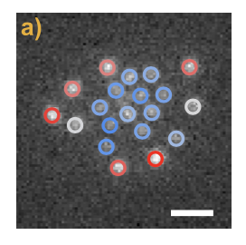
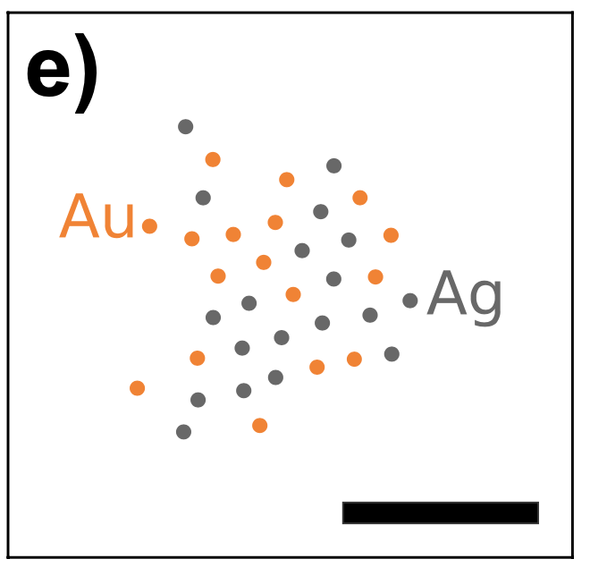
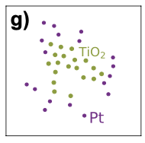
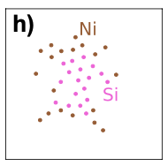
Separating optically trapped mixtures of particles by size and material
Experiment (red = brighter particles)
Separation by particle size
Emmanuel Valenton, Curtis Peterson
Separation by particle material
Au-Ag fails to separate

Slide 11
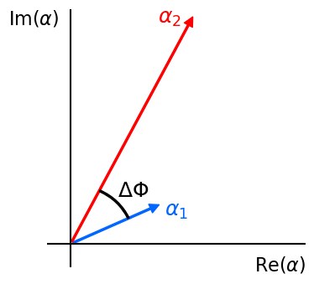
Pairwise force model for non-reciprocal interactions
Cycle-averaged force
RHC-polarized light
$$\left\langle F_{i}\right\rangle ∝ \frac{{\left\langle p_{i}\left(t\right)⋅p_{j}\left(t−r_{ij}/c\right)\right\rangle }_{ }}{r_{ij}}$$
Individual forces
$$F_{i}=Ap_{i}p_{j}\frac{\sin{(kr_{ij}+ΔΦ_{ij})}}{r_{ij}}$$
$$F_{j}=−Ap_{i}p_{j}\frac{\sin{(kr_{ij}−ΔΦ_{ij})}}{r_{ij}}$$
Force sum and difference
$$F_{i}+F_{j}=2Ap_{i}p_{j}\sin{(ΔΦ_{ij})}\frac{\cos{(kr_{ij})}}{r_{ij}}$$
$$F_{i}−F_{j}=2Ap_{i}p_{j}\cos{(ΔΦ_{ij})}\frac{\sin{(kr_{ij})}}{r_{ij}}$$
$$α\left(ω\right)=α^{′}\left(ω\right)+iα^{′′}(ω)$$
$$p\left(ω\right)=α\left(ω\right)E_{inc}$$

Slide 12
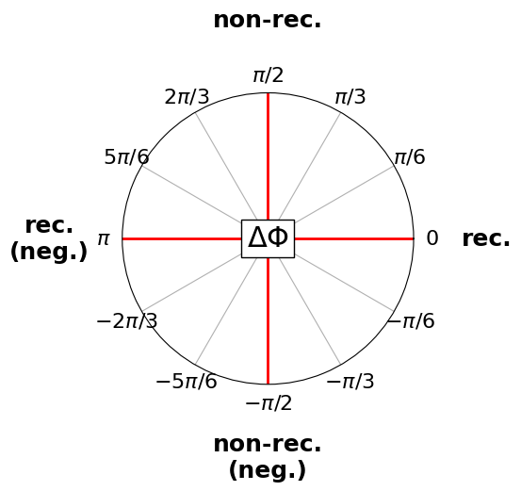
Polar diagram of the reciprocal and non-reciprocal interactions
$$F_{i}+F_{j}=2Ap_{i}p_{j}\sin{(ΔΦ_{ij})}\frac{\cos{(kr_{ij})}}{r_{ij}}$$
$$F_{i}−F_{j}=2Ap_{i}p_{j}\cos{(ΔΦ_{ij})}\frac{\sin{(kr_{ij})}}{r_{ij}}$$

Slide 13
Model dynamics with two species of nanoparticles
$$p_{1}=1$$
$$Φ_{1}=0$$
$p_{2}=2$
$$Φ_{2}=0.7$$
$$F_{i}=Ap_{i}p_{j}\frac{\sin{(kr_{ij}+ΔΦ_{ij})}}{r_{ij}}$$
$$F_{j}=−Ap_{i}p_{j}\frac{\sin{(kr_{ij}−ΔΦ_{ij})}}{r_{ij}}$$
91 particles

Slide 14
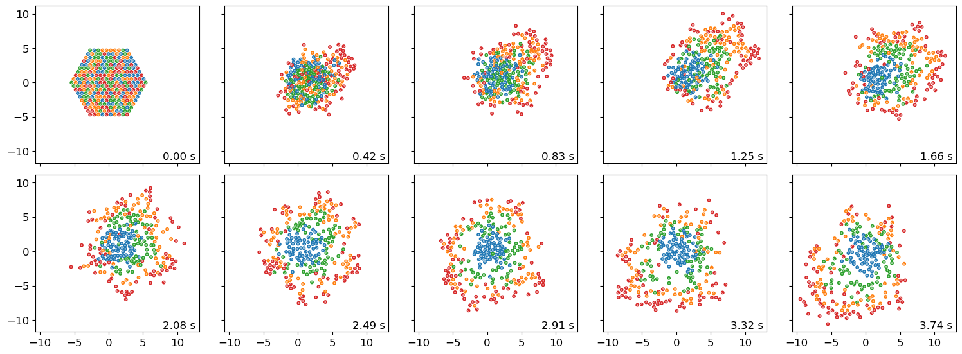
Model dynamics with four species of nanoparticles
$$p_{1}=1$$
$$Φ_{1}=0$$
$$p_{3}=1.6$$
$$Φ_{3}=1.0$$
$$p_{2}=1.3$$
$$Φ_{2}=0.5$$
$$p_{4}=1.9$$
$$Φ_{4}=1.5$$
$$F_{i}=Ap_{i}p_{j}\frac{\sin{(kr_{ij}+ΔΦ_{ij})}}{r_{ij}}$$
$$F_{j}=−Ap_{i}p_{j}\frac{\sin{(kr_{ij}−ΔΦ_{ij})}}{r_{ij}}$$
271 particles

Slide 15
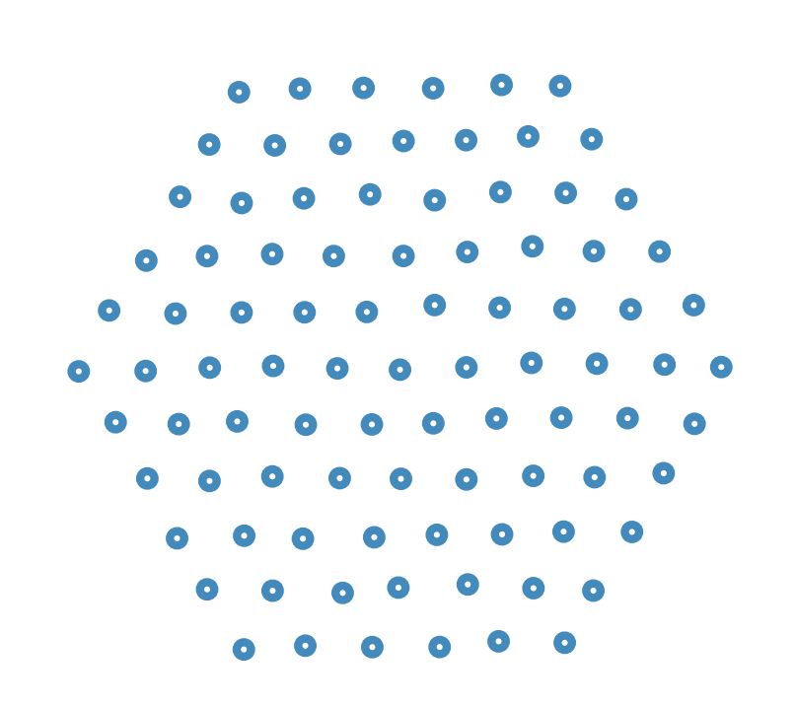
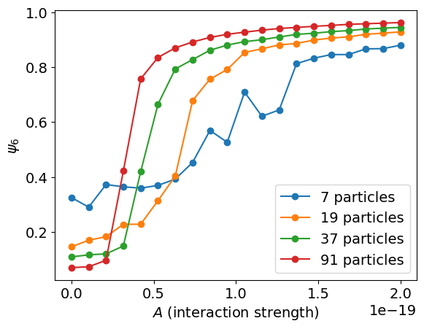
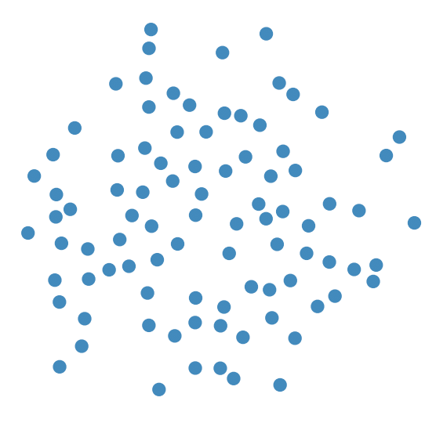
Phase transition due to increasing interaction strength
High hexagonal order
Low hexagonal order

Slide 16
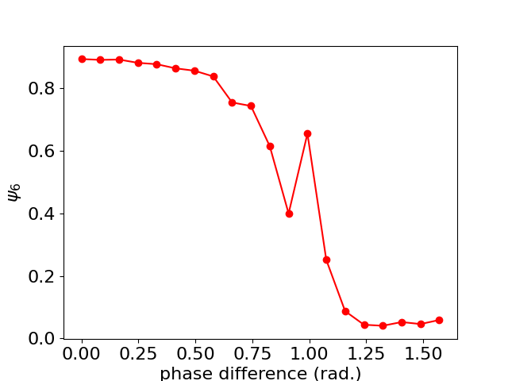
Phase transition due to increasing phase difference (non-reciprocal strength)
High hexagonal order
Low hexagonal order

Slide 17
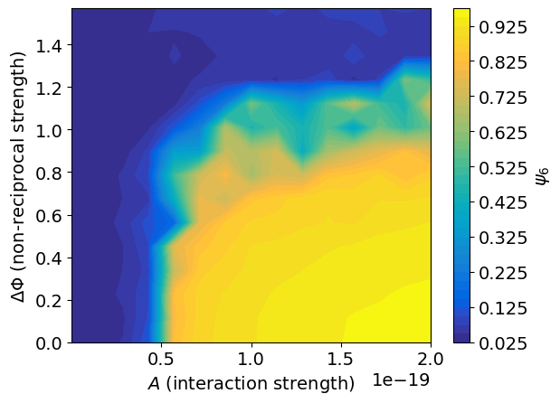
Phase transition diagram from variable interaction strength and non-reciprocal strength

Slide 18
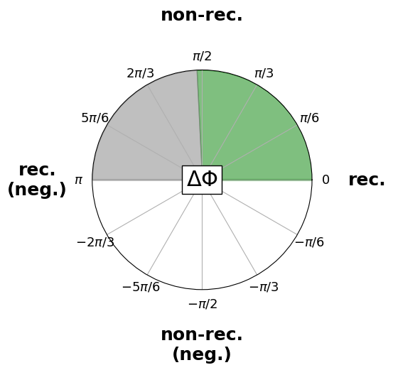
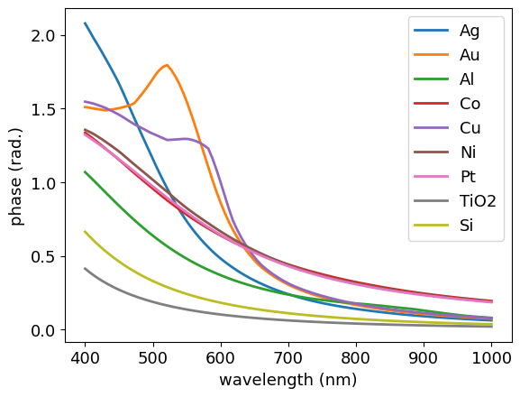
Obtainable phase difference using real nanoparticles
100 nm diameter nanoparticles
Obtainable phase difference
?
At $λ=520$ nm, Au-TiO₂ mixtures have a $π/2$ phase difference

Slide 19
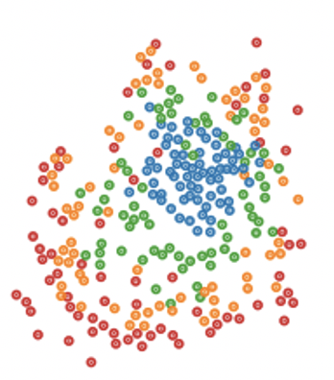
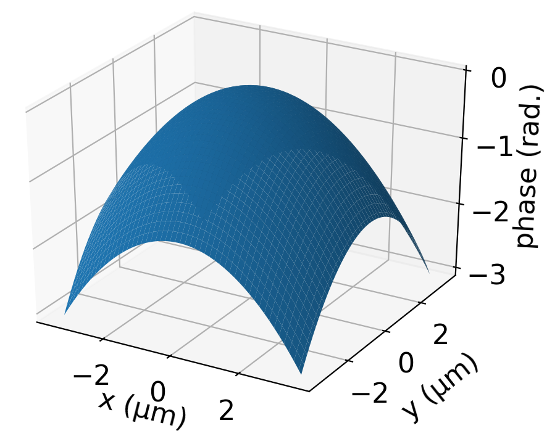
Ongoing research
Order parameter and phase transitions for the segregation of nanoparticle mixtures
Using the phase of light to control the non-reciprocal interactions
Non-reciprocal interactions induced by many-body interactions (failure of the pairwise force model)
$${φ(\vec{r})=φ_{int}+φ}_{ext}(\vec{r})$$

Slide 20
Thank you! Questions?

