Slide 1
Department of Physics
Collective electrodynamic excitations and non-conservative dynamics in optical matter and meta-atom systems
John Parker
The University of Chicago

Slide 2
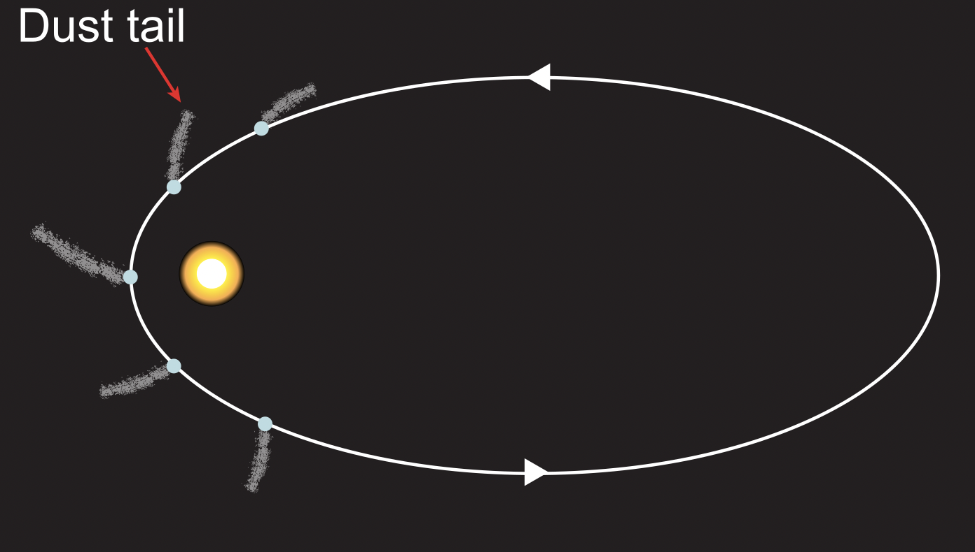
Light exerts a force on matter
Dust tails in comets feel radiation pressure from the sun
Nanoparticles confined in tightly focused light beams
Ref: Юкатан
Ref: Thor Labs
Momentum per photon
Field momentum (classical)
Optical forces become significant at the nanoscale in the presence of thermal fluctuations
$$p=\frac{h}{λ}$$
$$P=\frac{\left\langle S\right\rangle }{c}=\frac{\left\langle E×H\right\rangle }{c}$$
Pelton, M., Liu, M., Kim, H. Y., Smith, G., Guyot-Sionnest, P., & Scherer, N. F. (2006). Optical trapping and alignment of single gold nanorods by using plasmon resonances. Optics letters, 31(13), 2075-2077.
Whipple, F.L., 1978. Comets. codu, pp.1-73.
The University of Chicago
The University of Chicago
Introduction to optical trapping and optical matter

Slide 3
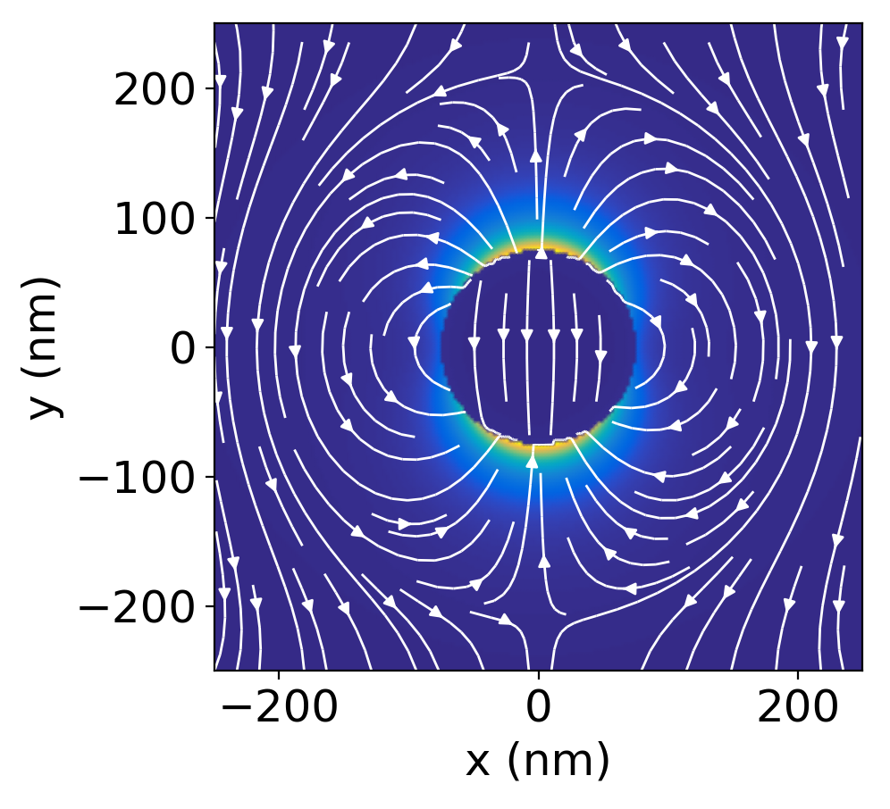
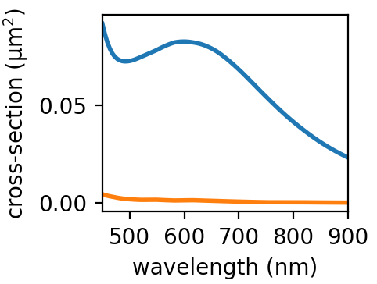
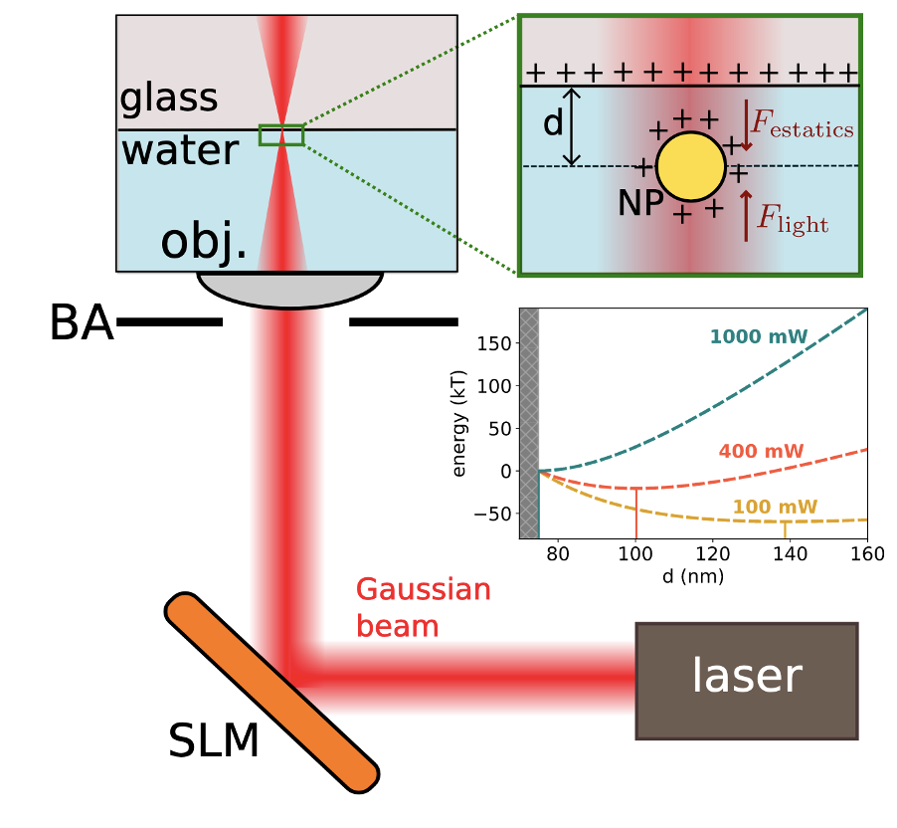
Trapping a single particle in a Gaussian beam
Dipole field around a 150 nm diameter silver nanoparticle
Scattering and absorption of the nanoparticle particle
Optical setup for trapping nanoparticles
scattering
absorption
Nanoparticle polarizability (Raleigh approximation)
$$α\left(ω\right)=α^{′}\left(ω\right)+iα^{′′}(ω)$$
$$p\left(ω\right)=α\left(ω\right)E_{inc}$$
Trapping particles in the $z$-direction
$$F_{z}=F_{rad}−F_{Coulomb}=0$$
The University of Chicago
The University of Chicago
Introduction to optical trapping and optical matter

Slide 4
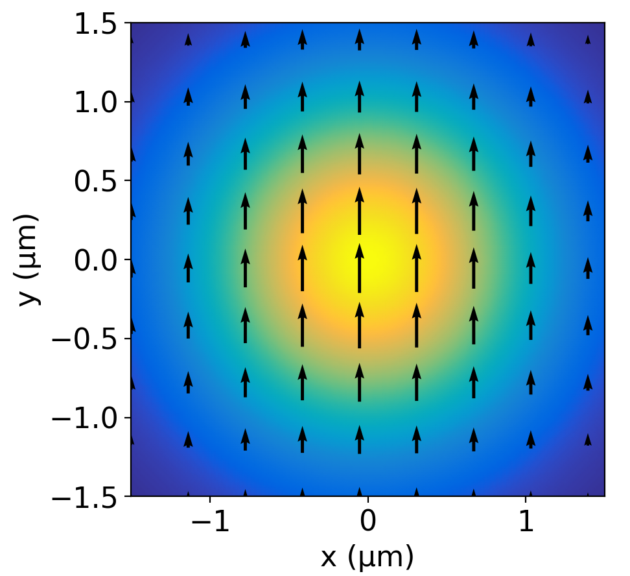
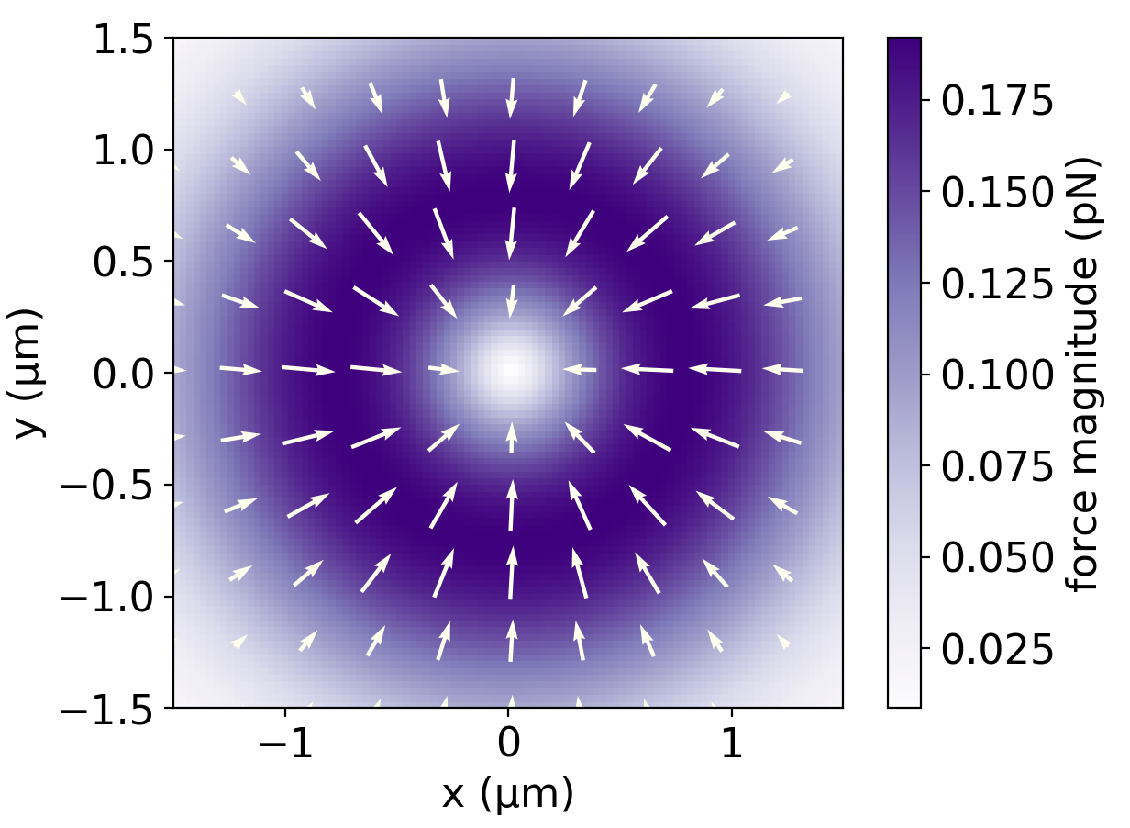
Trapping a single particle in a Gaussian beam
Brownian dynamics simulation for the trajectory of the trapped particle
y-polarized Gaussian beam
Force field for trapped nanoparticle
Focused beam profile (monochromatic)
Optical intensity and phase gradient forces (trapping in $xy$-plane)
Brownian fluctuations from the thermal bath (water medium)
The University of Chicago
The University of Chicago
Introduction to optical trapping and optical matter

Slide 5
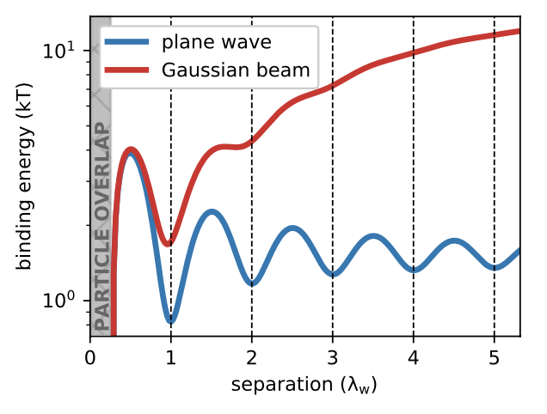
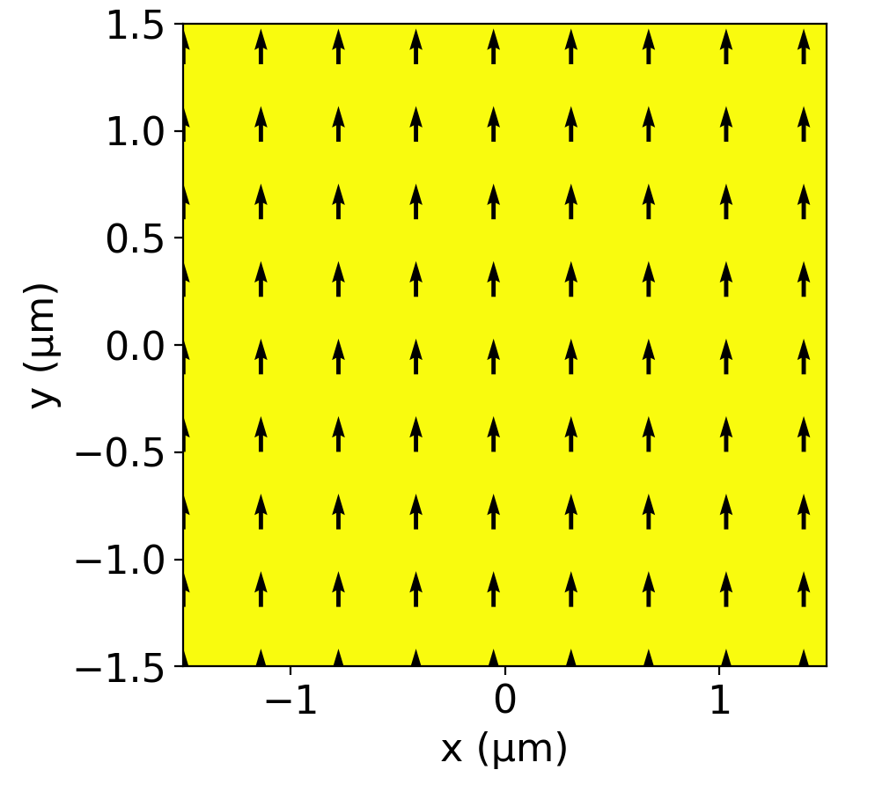
Two particles interact with each other electrodynamically to form a bound dimer
Gaussian beam
Optical binding energy for two particles
When a second particle is added to an optical trap, it interacts electrodynamically with the other particle
The binding is stable at various optical binding separations
$δ=n{ λ}_{w} n=1, 2, …$
Plane wave
$$δ$$
The University of Chicago
The University of Chicago
Introduction to optical trapping and optical matter

Slide 6
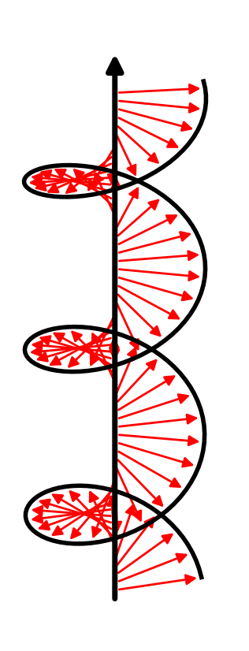
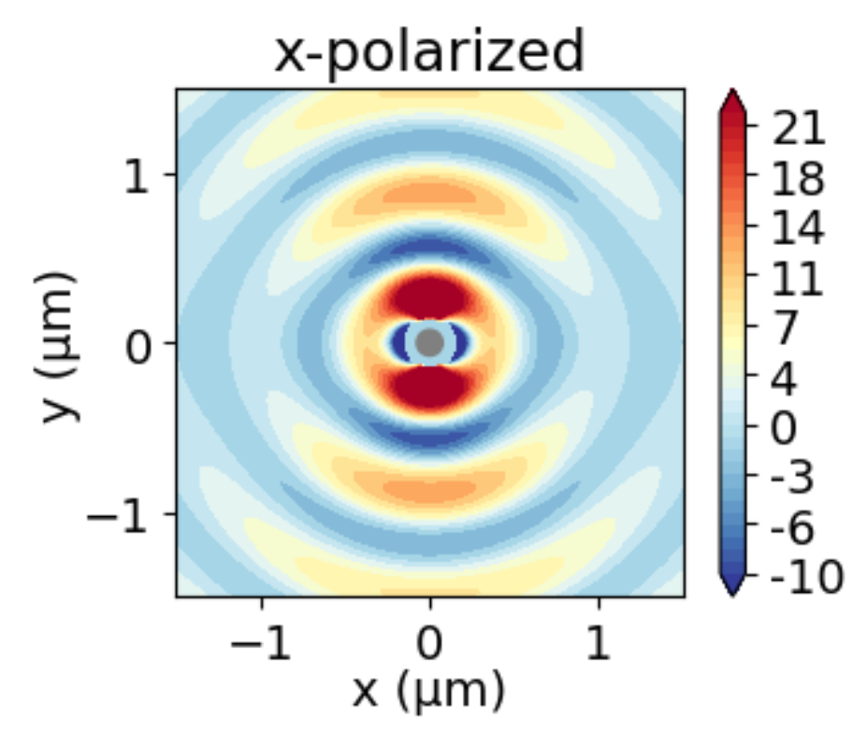
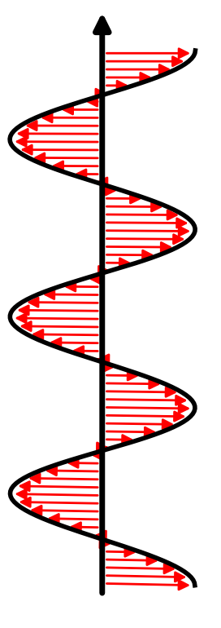
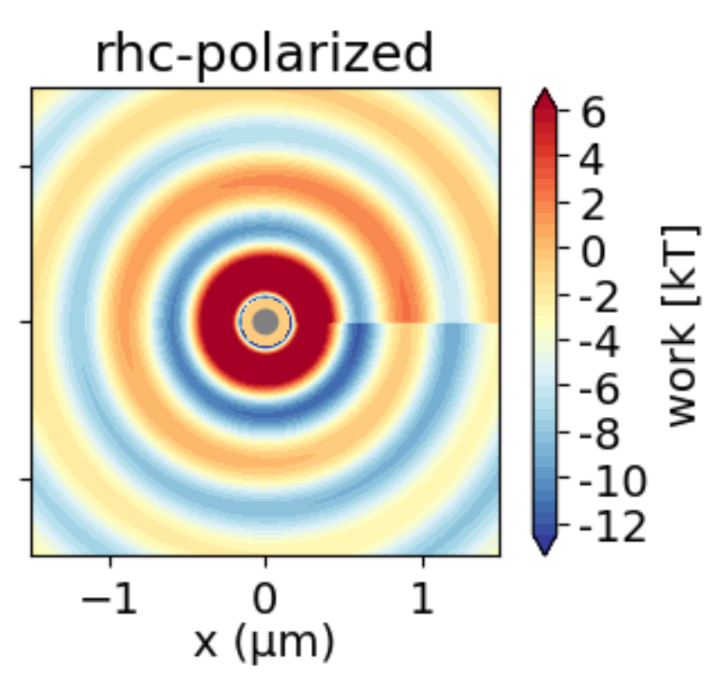
Dimers forming in linearly and circularly polarized light: conservative and non-conservative forces
Linear polarization
Circular polarization
Work landscapes for a second particle
$$\vec{k}$$
$$\vec{E}$$
$$\vec{k}$$
$$\vec{E}$$
With linearly polarized light, the forces are conservative
With circularly polarized light, the forces are non-conservative: the work to move the second particle around a closed loop is non-zero
Particle at the origin
The University of Chicago
The University of Chicago
Introduction to optical trapping and optical matter

Slide 7
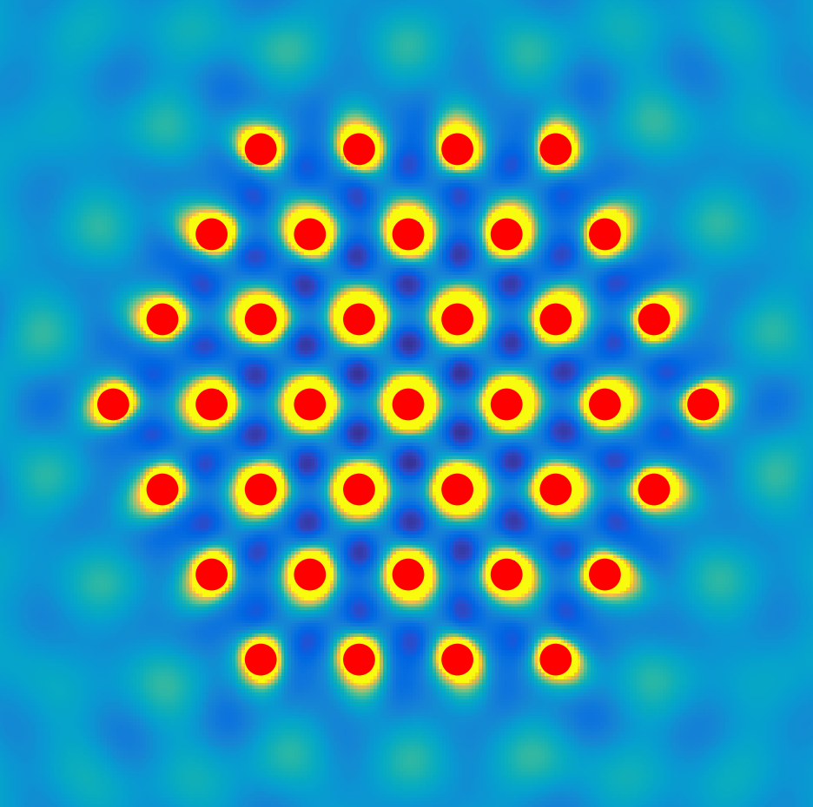
Building larger optical matter arrays in circularly polarized light
Building optical matter arrays 1 particle at a time (colormap = light intensity)
Interference between incident and scattered fields
37 nanoparticle optical matter array
$$I(\vec{r})={\left({\vec{E}}_{inc}(\vec{r})+\sum_{i}{{{\vec{E}}^{i}}_{scat}}(\vec{r})\right)}^{2}$$
Force field landscape
$$\vec{F}(\vec{r})∝\vec{∇}I(\vec{r})$$
The University of Chicago
The University of Chicago
Introduction to optical trapping and optical matter

Slide 8
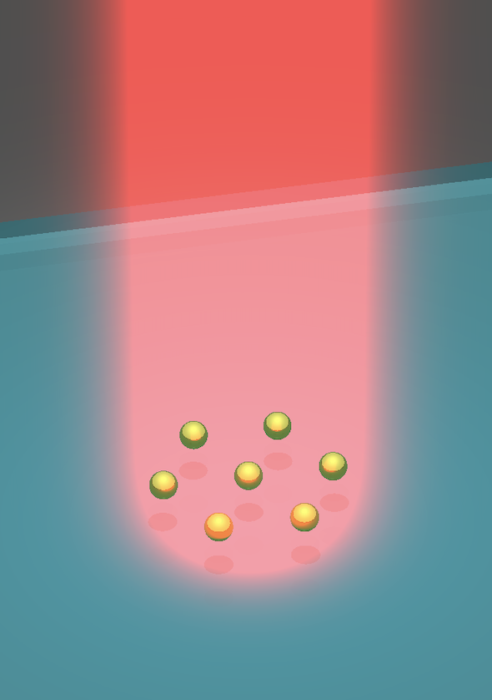
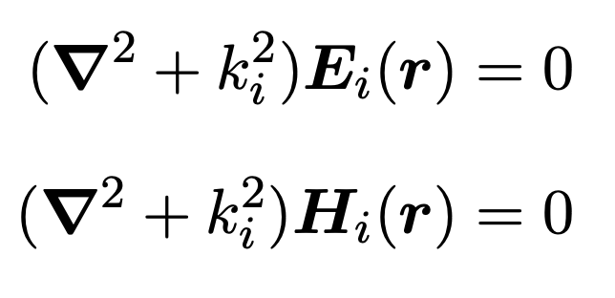
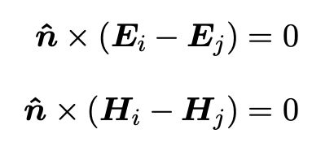
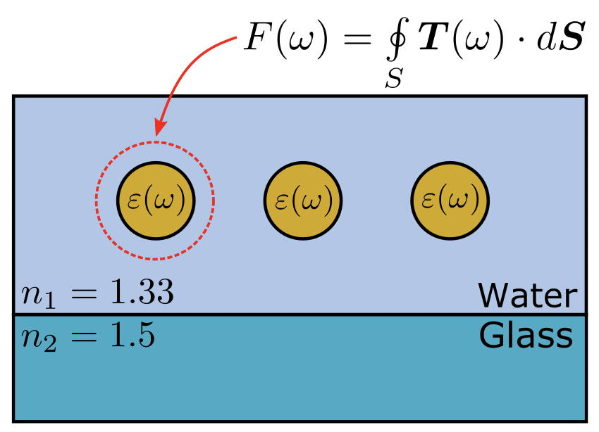
Efficient simulation of electrodynamic interactions in optical matter
Maxwell’s equations
Piecewise uniform vector Helmholtz equation
Calculate optical forces on each particle
Langevin equation of motion
inertia
friction
noise
electrodynamic
The University of Chicago
The University of Chicago
Introduction to optical trapping and optical matter

Slide 9
Visualizing the construction of optical matter in simulation and experiment
Experiment showing assembly of optical matter
XZ view of optical matter
XY view of optical matter
Zijie Yan
The University of Chicago
The University of Chicago
Introduction to optical trapping and optical matter

Slide 10
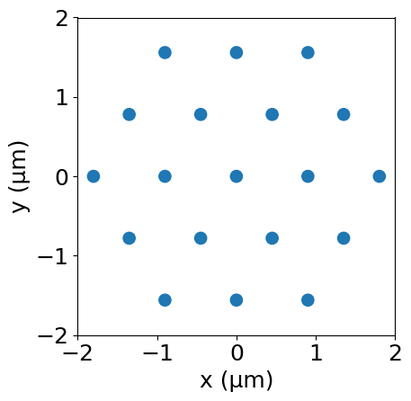
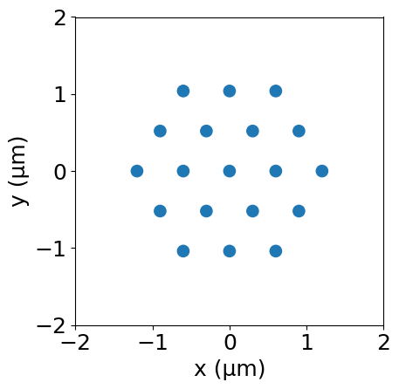
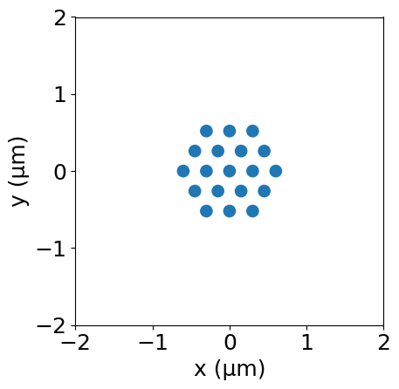
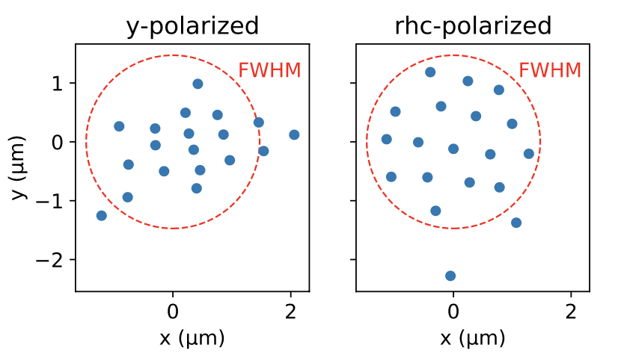
Controlling optical matter with the wavelength, polarization, and intensity of light
$λ_{w}=900$ nm
$λ_{w}=600$ nm
$λ_{w}=300$ nm
Wavelength of light controls the lattice spacing in optical matter
$$δ≈\frac{λ}{n_{b}}=\frac{λ}{1.33}=λ_{w}$$
Polarization controls the lattice geometry
linearly polarized → prefers linear chains
circularly polarized → prefers hexagonal packing
Beam power controls the strength of the interactions
FWHM = full-width at half maximum
The University of Chicago
The University of Chicago
Introduction to optical trapping and optical matter

Slide 11
Non-reciprocal interactions in optical matter systems
The University of Chicago
The University of Chicago
Non-reciprocal interactions in optical matter systems

Slide 12
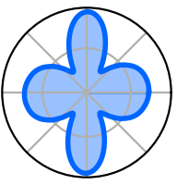
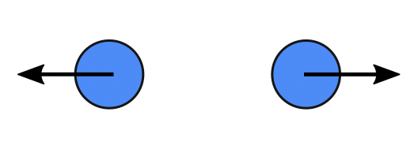
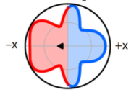
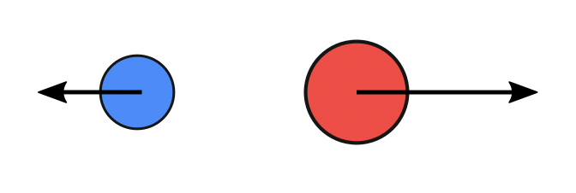
Action does not equal reaction in an optically bound hetero-dimer
Far-field angular scattering (symmetric)
Optically bound homo-dimer
$${\vec{F}}_{1}$$
$${\vec{F}}_{2}$$
For two identical particles, Newton’s third law is valid
For two dissimilar particles, Newton’s third law is not valid
Linear momentum is still conserved in the combined optical – mechanical system
$${\vec{F}}_{1}=−{\vec{F}}_{2}$$
$$F^{net}=0$$
Far-field angular scattering (asymmetric)
Optically bound hetero-dimer
$${\vec{F}}_{1}$$
$${\vec{F}}_{2}$$
$$F^{net}$$
$${\vec{F}}_{1}≠−{\vec{F}}_{2}$$
Yifat, Y., Coursault, D., Peterson, C.W., Parker, J., Bao, Y., Gray, S.K., Rice, S.A. and Scherer, N.F., 2018. Reactive optical matter: light-induced motility in electrodynamically asymmetric nanoscale scatterers. Light: Science & Applications, 7(1), pp.1-7.
The University of Chicago
The University of Chicago
Non-reciprocal interactions in optical matter systems

Slide 13
Observing a driven hetero-dimer in simulation and experiment
Experiment
Plane-wave
In a plane-wave, the hetero-dimer will be driven forever
The net force is not external; it emerges from the optical interactions
The driven motion can be observed experimentally in a ring trap (that does not have an azimuthal phase gradient)
$$F^{net}$$
Hetero-dimer (driven)
Homo-dimer (not driven)
Yuval Yifat, Curtis Peterson
Yifat, Y., Coursault, D., Peterson, C.W., Parker, J., Bao, Y., Gray, S.K., Rice, S.A. and Scherer, N.F., 2018. Reactive optical matter: light-induced motility in electrodynamically asymmetric nanoscale scatterers. Light: Science & Applications, 7(1), pp.1-7.
The University of Chicago
The University of Chicago
Non-reciprocal interactions in optical matter systems

Slide 14
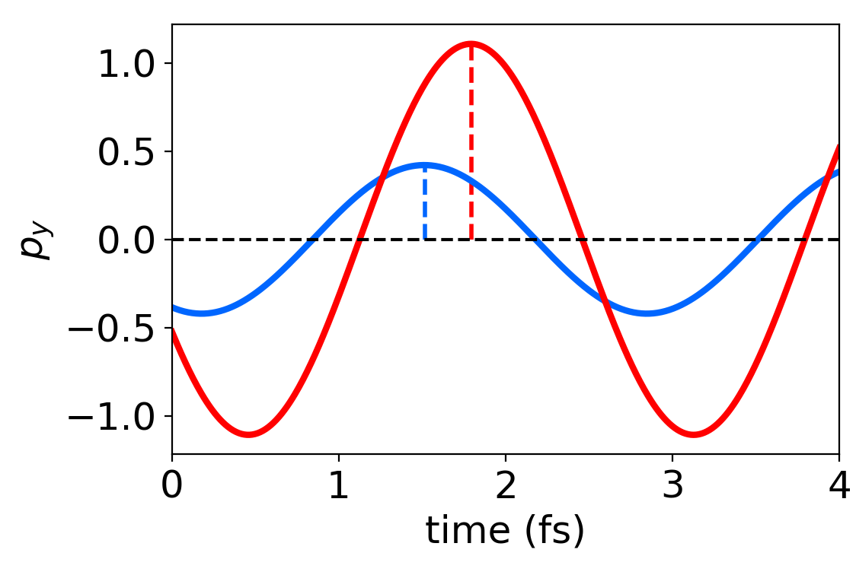
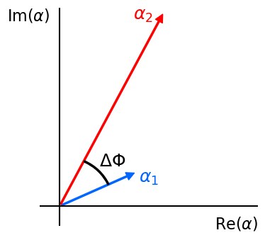
The phase difference between induced dipoles causes a net mechanical force
Time domain
Net force between two particles
$$F_{12}^{net}∝P\left|α_{1}\right|\left|α_{2}\right|\sin{(ΔΦ_{ij}})$$
$y$-polarized light
Phase difference between induced dipoles
${ΔΦ}_{ij}=∠(p_{i}/p_{j})=∠(α_{i}E_{i}/α_{j}E_{j}$)
Phase of dipoles
Frequency domain
$$\vec{p}=α\vec{E}\left(\vec{r}\right)$$
$={\hat{n}}_{E} α_{0}e^{iφ_{int}}∗E_{0}(\vec{r})e^{iφ_{ext}(\vec{r})}$
$$={\hat{n}}_{E} α_{0}E_{0}(\vec{r})e^{i{[φ_{int}+φ}_{ext}(\vec{r})]}$$
RHC-polarized light
$${φ(\vec{r})=φ_{int}+φ}_{ext}(\vec{r})$$
$φ_{int}$:
Intrinsic (constant) phase
$φ_{ext}(\vec{r})$:
Extrinsic (position-dependent) phase
Peterson, C.W., Parker, J., Rice, S.A. and Scherer, N.F., 2019. Controlling the dynamics and optical binding of nanoparticle homodimers with transverse phase gradients. Nano letters, 19(2), pp.897-903.
The University of Chicago
The University of Chicago
Non-reciprocal interactions in optical matter systems

Slide 15
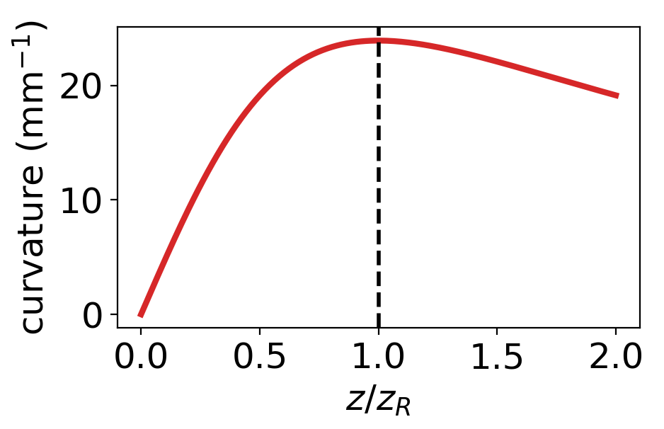
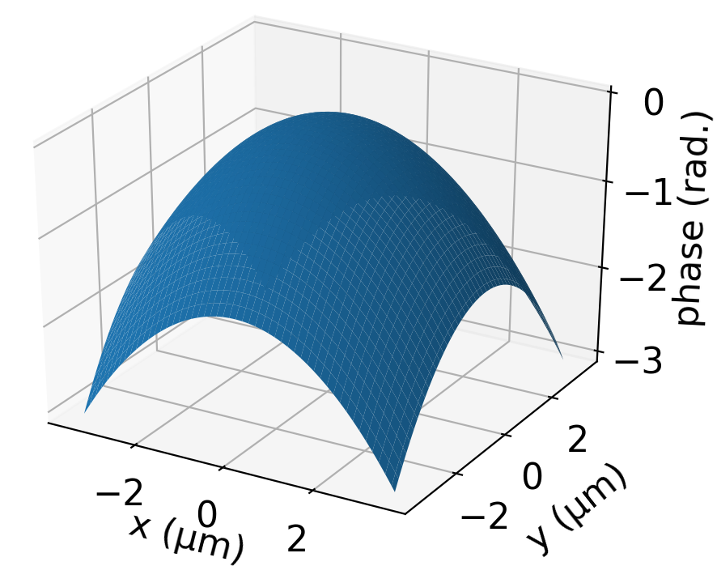
The radius of curvature of a Gaussian beam provides an extrinsic phase profile
Beam curvature is maximized at the Raleigh range
Extrinsic phase profile of a defocused Gaussian beam
$$Φ_{ext}\left(ρ, z\right)=\frac{kρ^{2}}{2R(z)}=\frac{kzρ^{2}}{2(z^{2}+z_{R}^{2})}$$
2D phase profile at $z=−z_{R}$
$z_{R}=\frac{1}{2}kw_{0}^{2}$ (Rayleigh range)
The extrinsic phase profile is strongest at the Rayleigh range
$$Φ_{ext}\left(ρ, z={−z}_{R}\right)=−\frac{k}{4z_{R}}ρ^{2}$$
The University of Chicago
The University of Chicago
Non-reciprocal interactions in optical matter systems

Slide 16
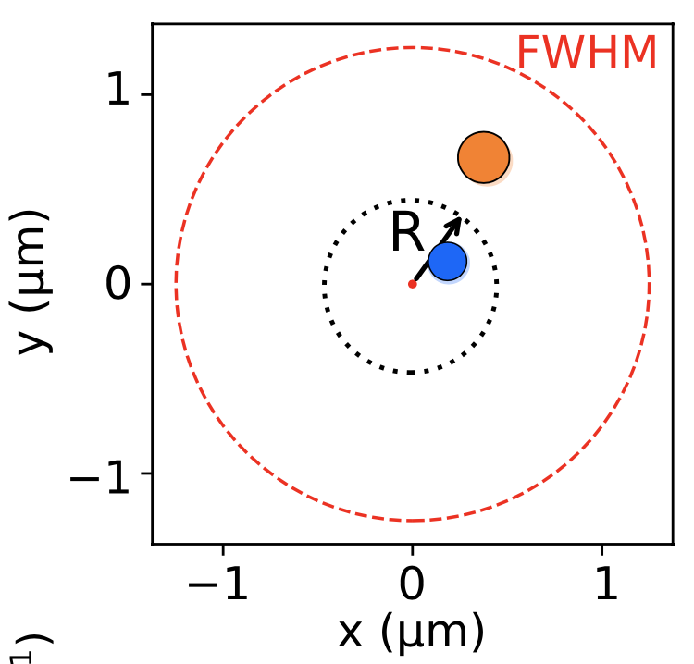
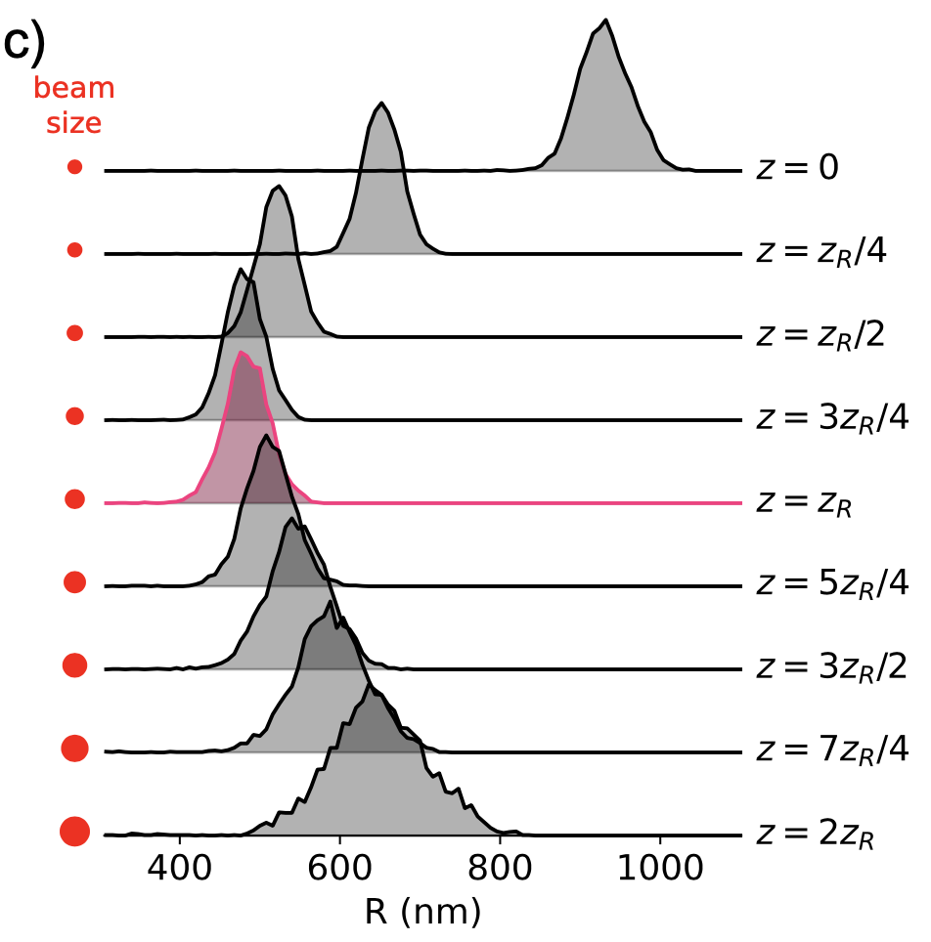
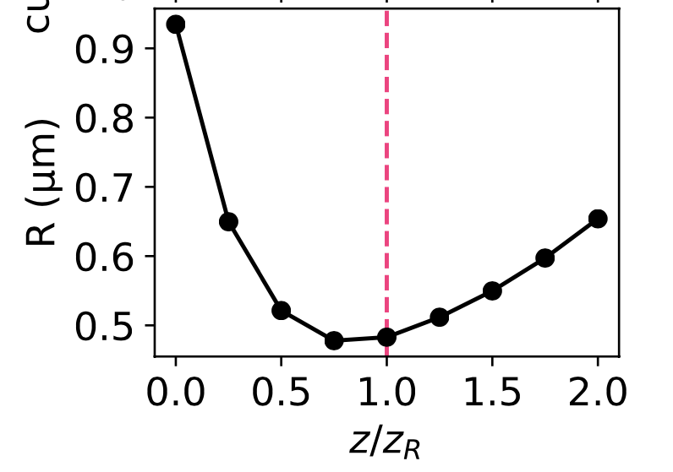
Enhanced trapping of a hetero-dimer in two dimensions using a converging Gaussian beam
A hetero-dimer trapped in a Gaussian beam still experiences a net force
The extrinsic phase of a defocused Gaussian beam increases the ability to trap the hetero-dimer
The optimal trapping condition is near the Rayleigh range, $z=z_{R}$
The University of Chicago
The University of Chicago
Non-reciprocal interactions in optical matter systems

Slide 17
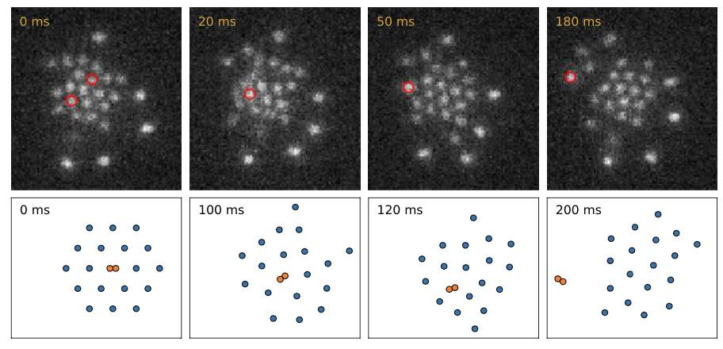
An intruder particle is expelled from an optical matter array though non-reciprocal interactions
Averaged over thermal fluctuations
An intruder particle is ejected from an array by non-conservative forces
Emmanuel Valenton, Curtis Peterson
The above transition cannot be easily realized in experiment
Alternatively, the intruder can be a dimer: two identical near-field bonded particles
Dimers can form in experiment spontaneously
Manuscript in preparation (2020)
The University of Chicago
The University of Chicago
Non-reciprocal interactions in optical matter systems

Slide 18
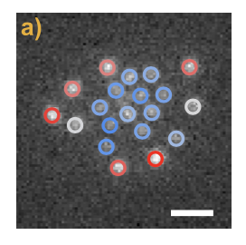
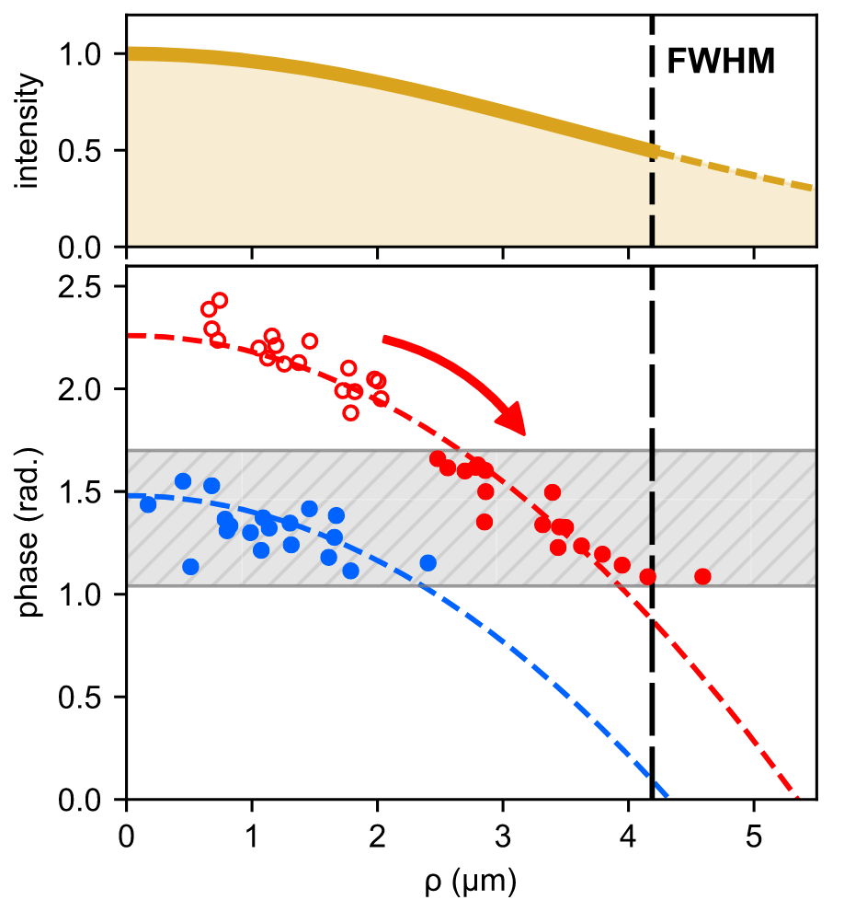
Separating optically trapped mixtures of particles by size using a stabilizing extrinsic phase
Experiment (red = brighter particles)
Emmanuel Valenton, Curtis Peterson
Larger particles make their way to the outside of the array
At steady-sate, the non-reciprocal forces vanish on average
$ΔΦ_{ij}→0$ in steady-state
The larger particles move to the outside of the beam to lower their phase
$$Φ_{i}(ρ)=Φ_{i}−\frac{k}{4z_{R}}ρ^{2}$$
Manuscript in preparation (2020)
The University of Chicago
The University of Chicago
Non-reciprocal interactions in optical matter systems

Slide 19
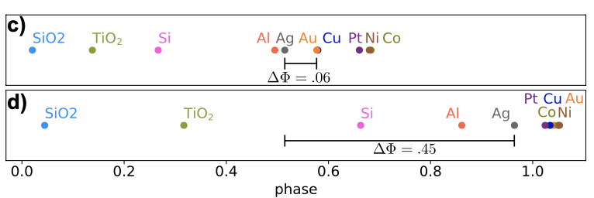
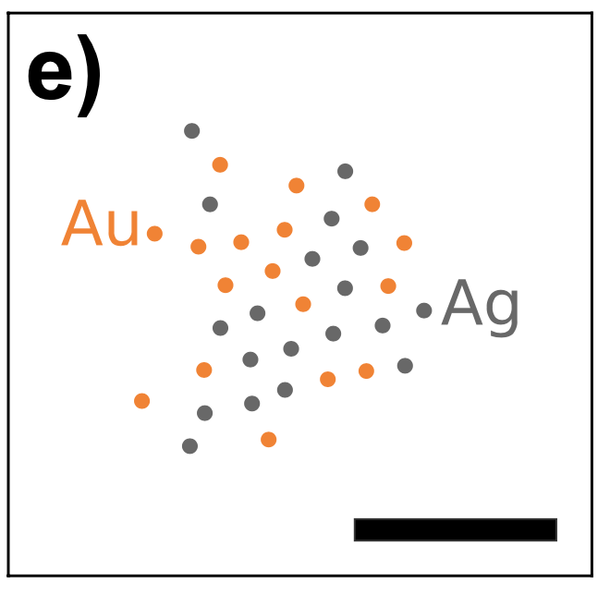
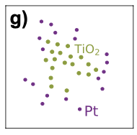
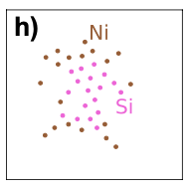
Separating optically trapped mixtures of particles by material
Intrinsic phase of nanoparticles composed of different materials
$$R=75 nm$$
$$R=100 nm$$
Nanoparticle mixtures can also be separated by material
For some material combinations (Ag-Au), the phase difference is too small for separation to occur
The University of Chicago
The University of Chicago
Non-reciprocal interactions in optical matter systems

Slide 20
Using optical angular momentum to create stochastic optical matter machines
The University of Chicago
The University of Chicago
Using optical angular momentum to create stochastic optical matter machines

Slide 21
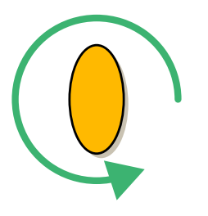
Circularly polarized light exerts a torque on trapped nanoparticles
$$\vec{k}$$
$$E^{inc}$$
$$\vec{E}$$
There is a torque due to asymmetric scattering in anisotropic particles
There is a torque due to absorption of circularly polarized photons in spherical particles
For silver nanoparticles, the absorption is very small
$$Video sped up 100×$$
Pelton, M., Liu, M., Kim, H. Y., Smith, G., Guyot-Sionnest, P., & Scherer, N. F. (2006). Optical trapping and alignment of single gold nanorods by using plasmon resonances. Optics letters, 31(13), 2075-2077.
The University of Chicago
The University of Chicago
Using optical angular momentum to create stochastic optical matter machines

Slide 22
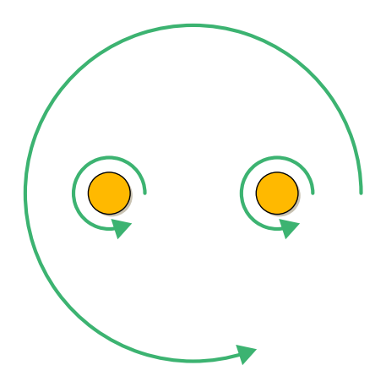
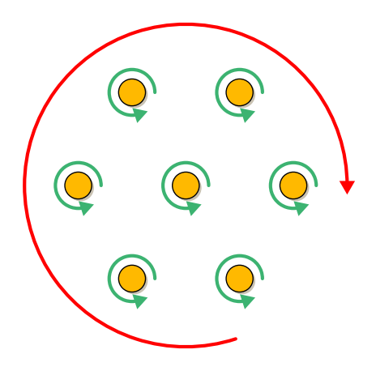
Optical matter experiences a net orbital torque that can be positive or negative
$$E^{inc}$$
The spin angular momentum of light induces an orbital torque in optical matter arrays
The torque can be positive or negative
The field scattered by the optical matter array generally carries orbital angular momentum
The University of Chicago
The University of Chicago
Using optical angular momentum to create stochastic optical matter machines

Slide 23
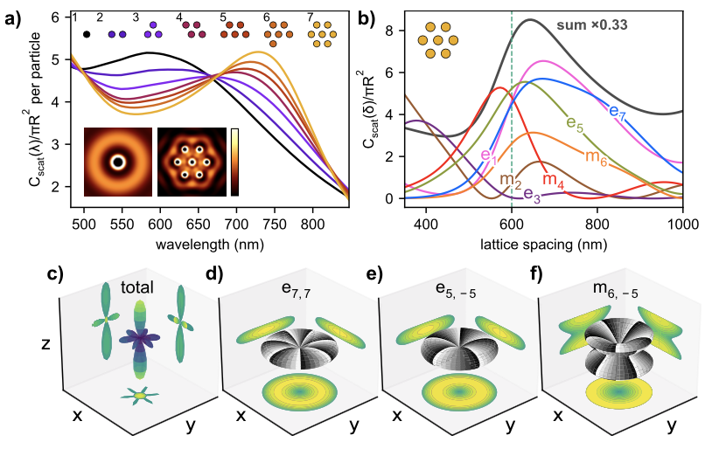
Collective scattering modes of optical matter arrays carry angular momentum
Scattering modes of a 7NP optical matter array
Collective scattering modes (multipoles)
$N_{nm}$ (electric), $M_{nm}$ (magnetic)
$$n=1,2,…$$
$$m=−n,…0,…,+n$$
Scattered angular momentum has directionality
Angular scattering of multipolar modes
$e_{7,7}$ mode scatters positive orbital angular momentum ($m=7$) in the $xy$-plane
Angular momentum selection rule
$q$ is an integer, $m_{s}=6$ is the discrete rotational symmetry, and $m_{inc}=+1$ for RHC light
Parker, J., Peterson, C.W., Yifat, Y., Yan Z., Gray, S.K., Rice, S.A. and Scherer, N.F., 2020. An Optical Matter Machine: Angular Momentum Conversion by Collective Modes in Optically Bound Nanoparticle Arrays. Optica (accepted)
The University of Chicago
The University of Chicago
Using optical angular momentum to create stochastic optical matter machines

Slide 24
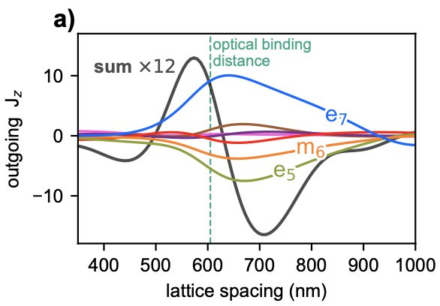
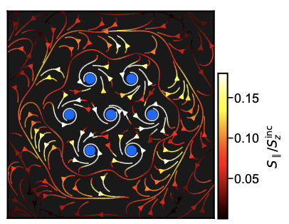
Spin–Orbit angular momentum conversion in rotationally symmetric arrays
Flow of electromagnetic energy around the OM array
Outgoing angular momentum
Rate of outgoing angular momentum per mode
Parker, J., Peterson, C.W., Yifat, Y., Yan Z., Gray, S.K., Rice, S.A. and Scherer, N.F., 2020. An Optical Matter Machine: Angular Momentum Conversion by Collective Modes in Optically Bound Nanoparticle Arrays. Optica (accepted)
The University of Chicago
The University of Chicago
Using optical angular momentum to create stochastic optical matter machines

Slide 25
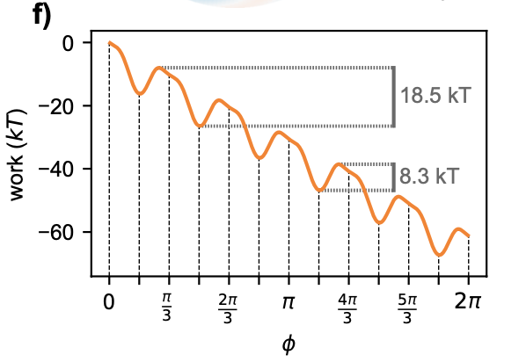
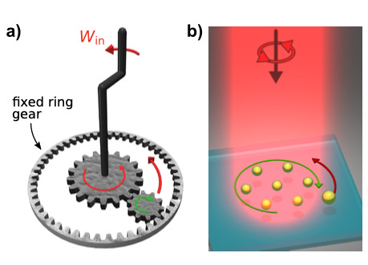
Realizing a stochastic optical matter machine in simulation and experiment
Planetary gear machine
Optical matter machine
Counter-rotation of optical matter machine
Tilted periodic work curve (stochastic machine)
Simulation
Experiment
Yuval Yifat, Curtis Peterson
Optical matter machine relies on spin—orbit conversion of the central 7 nanoparticles
A non-conservative force is exerted on the outer particle, driving its orbital motion
The machine is stochastic: thermal fluctuations are required for it to operate
Parker, J., Peterson, C.W., Yifat, Y., Yan Z., Gray, S.K., Rice, S.A. and Scherer, N.F., 2020. An Optical Matter Machine: Angular Momentum Conversion by Collective Modes in Optically Bound Nanoparticle Arrays. Optica (accepted)
The University of Chicago
The University of Chicago
Using optical angular momentum to create stochastic optical matter machines

Slide 26
Constructing an optical matter machine via optical binding and non-reciprocal interactions
Adding 1 particle to the trap at a time
Simulation
Experiment
Non-reciprocal interactions guarantee the probe is on the outside of the array
The machine operates in a non-equilibrium steady-state
Yuval Yifat, Curtis Peterson
The University of Chicago
The University of Chicago
Using optical angular momentum to create stochastic optical matter machines

Slide 27
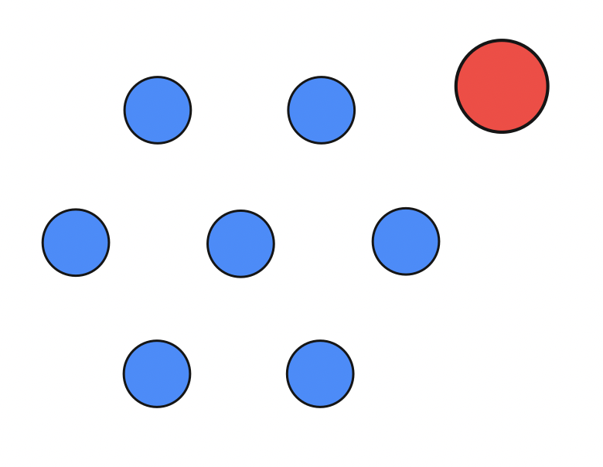
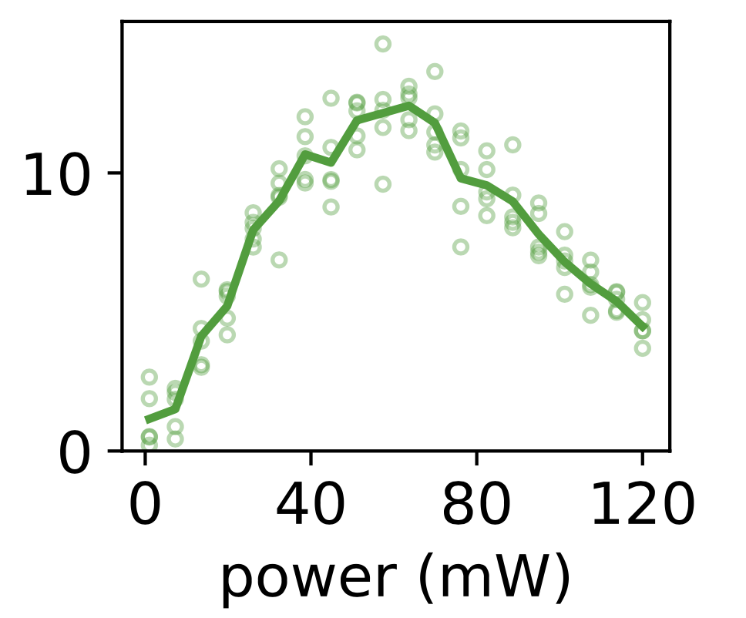
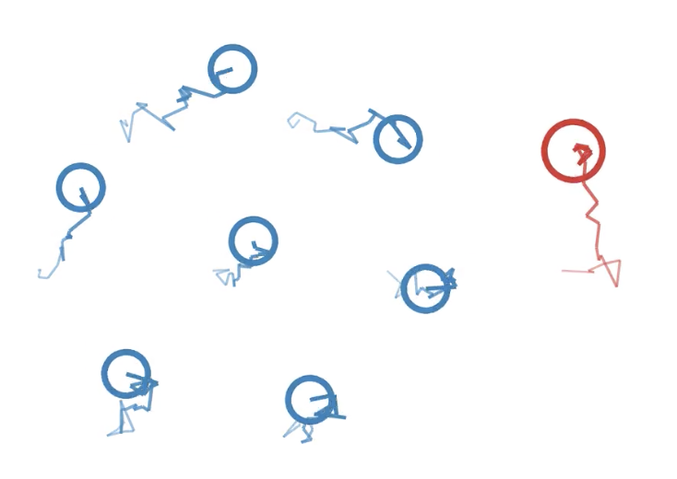
The efficiency of stochastic optical matter machines depends on the beam power
Probe
Efficiency of the stochastic optical matter machine:
Gear
efficiency
The machines fails to operate if the beam power is too low since it is dominated by diffusive behavior
It also fails if the power is too high: thermal energy is needed for the probe to make hops
10 mW
60 mW
150 mW
Diffusive
Diffusive – Driven
Driven
The University of Chicago
The University of Chicago
Using optical angular momentum to create stochastic optical matter machines

Slide 28
Realizing different types of optical matter machines
Patterned machines (gear particles have fixed positions)
Larger machines
The University of Chicago
The University of Chicago
Using optical angular momentum to create stochastic optical matter machines

Slide 29
Meta-atoms and optical magnetism excited by vector beams
Core-satellite meta-atom
Azimuthally polarized vector beam
Selective induction of optical magnetic modes
Manna, U., Lee, J.H., Deng, T.S., Parker, J., Shepherd, N., Weizmann, Y. and Scherer, N.F., 2017. Selective induction of optical magnetism. Nano letters, 17(12), pp.7196-7206.
The University of Chicago
The University of Chicago
Optical magnetism and meta-atoms

Slide 30
Conclusion
Optical matter can be created and tuned by the properties of the incident light for the creation of functional materials that do work at the nanoscale
Optical matter is a novel physical system that experiences non-equilibrium phenomenon, non-conservative forces, and non-reciprocal interactions
Non-reciprocal interactions in optical matter lead to irreversible transitions that can be used to segregate nanoparticle mixtures by size and material
Optical matter arrays convert spin angular momentum of light into orbital angular momentum that can be utilized to create stochastic nanoscale machines
The University of Chicago
The University of Chicago

Slide 31
Acknowledgements
Norbert F. Scherer
Stephen K. Gray
The University of Chicago
The University of Chicago

Slide 32
Thank you!
Questions?

